Slide 1
PARKSIDE DANCE ACADEMY
Winter Showcase 2026
Repertoire Proposal, prepared for the Director's review
Jason Cooper, Choreographer and Senior Instructor
Submitted October 1, 2026 . Academy Theater, December 12 to 13
01 / 07

Slide 2
SUMMARY
A two act program, anchored and contemporary
A two act winter program that balances a classical anchor with a contemporary commission, sized for our Level 3 to Level 6 dancers and the Academy Theater's tech limitations.
Runtime target is ninety minutes including a fifteen minute intermission, December 12 and 13, 2026.
PROGRAM RUNTIME, MINUTES
90 min
runtime target
Dec 12 to 13
two performances
02 / 07

Slide 3
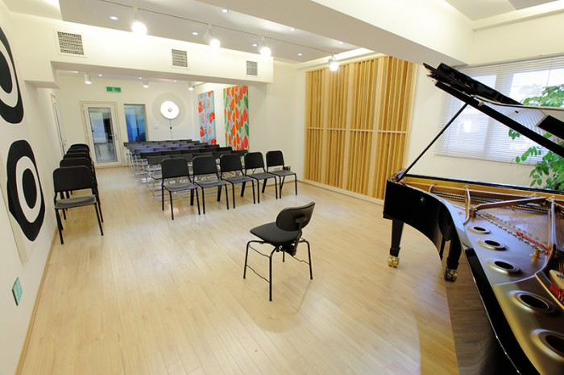
ACT ONE
The Nutcracker, Selected Divertissements
Snow Scene for the full Level 5 and 6 corps.
Waltz of the Flowers reduced to twelve dancers.
Spanish and Chinese variations for our advanced soloists.
Tchaikovsky is in the public domain, so there is no licensing fee, which protects the costume budget.
Choreography studio, where the program takes shape
03 / 07

Slide 4
ACT TWO
New Contemporary Commission
A fifteen minute ensemble piece set to a Bernstein style score, choreographed in studio across October and November.
This gives the older students repertoire they cannot find in a syllabus, and it gives the program a reason to exist beyond the familiar.
04 / 07

Slide 5
BUDGET AND TIMELINE
Costume reuse holds the spend under thirty five hundred dollars
Milestone | Date
Proposal to Director | October 1, 2026
Casting auditions | October 24, 2026
Casting posted | October 28, 2026
Tech week begins | December 7, 2026
Performances | December 12 to 13, 2026
Total planned budget, $3,400 against a $3,500 ceiling
05 / 07

Slide 6
OPEN QUESTIONS
Two decisions before casting
1. Orchestra pit or recorded score
Confirm whether the pit can be used, or whether we run a recorded score for the Tchaikovsky.
2. Two extra Saturday rehearsal blocks
Whether we can secure two added Saturday blocks in November for the commission.
06 / 07

Slide 7
Submitted for your review
Jason Cooper . Parkside Dance Academy . pwalsh@pda-dance.org
07 / 07

